Slide 1

Azure Lighthouse Azure Delegated Resource Management (ADRM)
Arturo Quiroga
Sr. Cloud Solution Architect – Azure App Innovation, IoT, AI
Microsoft Canada - GPS

Slide 2


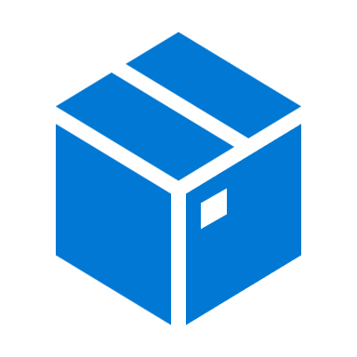








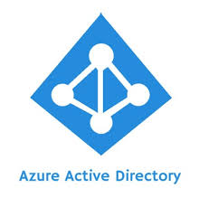

Azure Lighthouse - Delegated Resource Management - creates a logical (control plane) projection of the customer’s environment to the service provider’s environment
ARM validates the request is from a partner tenant and calls Managed Service Resource Provider (RP)
Managed service RP provides MSPs precise RBAC access
MSP completes the action on customer resource
1
MSP initiates an action for customer resource
2
3
4
CLI
Control plane
Existing 200+ Azure services
Azure Resource Management
PowerShell
Storage
Tags
RBAC
ARM Templates
Managed Services RP
Compute
REST API
Locks
Policy
Activity Log
c
Networking
Azure Portal
PaaS services

Slide 3
The Lighthouse architecture brings versatility and at-scale management capabilities into several scenarios
3
Accessing new customer markets, enabling partner to partner scenarios
Marketplace offers
ARM Template
APIs
2
Cross-tenant experience integrated into Azure and third-party services
Azure Policy
Azure Monitor
Azure Advisor
Azure Portal
Azure Kubernetes Service (AKS)
Azure Virtual Network
And more…
Azure Delegated Resource Management foundational fabric – it uses the Managed Services RP
1
1
Azure Resource Manager (ARM)
Azure Identity
Notes:
ADRM is the core of how we think of cross customer management. We all know that the tools we build are only one part of the equation. We want to make sure our tools fit into the ecosystem of our Azure services and our partner community and how you operate. We’ve built ADRM to be the foundational management fabric that is based on ARM and Azure Identity. The cross tenant experience we talked about can show up in your Azure services – whether you are enabling Log Analytics or Policy or Networking for your customer and we’ll show you an instance of how one of our partners enabled this soon. We truly believe we are in the next frontier of the managed services with these capabilities extended into various scenarios and your preferred method of going to market to your customer – whether it is a marketplace offer that automatically gives you access to the customers environment when they accept or through ARM templates or APIs that you used or through managed Apps that can build your MSP service into a 3rd party ISV solution which they can sell to the end customer.

Slide 4
Azure Lighthouse secret sauce: Project customer resources into partner environments
1
Customer resources, projected into service provider tenant to be managed by authorized service provider users
Service provider connects to each customer cloud individually, takes 4X the amount of time
BEFORE
AFTER
Service provider can perform CRUD (Create, Read, Update, Delete) operations at scope; PIM license required only on service provider tenant
Service provider tenant
Service provider directory
Service provider user group
Customer directory
Customer-1 Subscription
Customer-2 Subscription
Customer-3
Resource group
Customer-4 Resource group
Customer resources
Customer resources
Customer resources
Customer resources

Slide 5
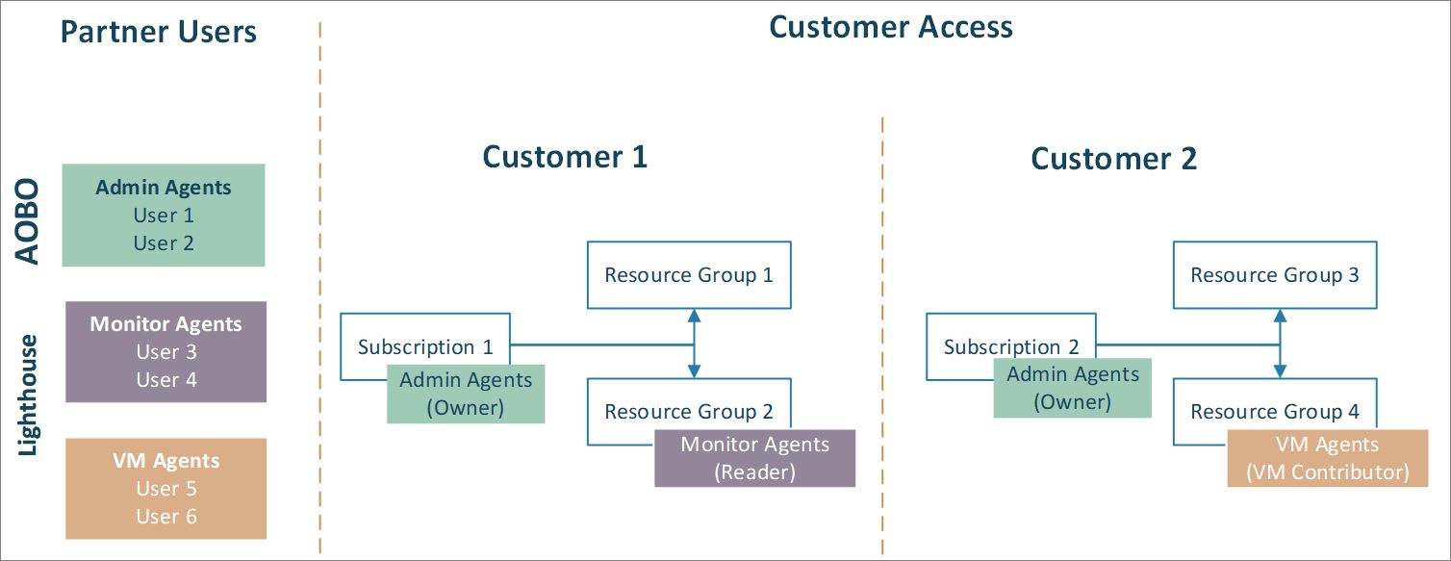
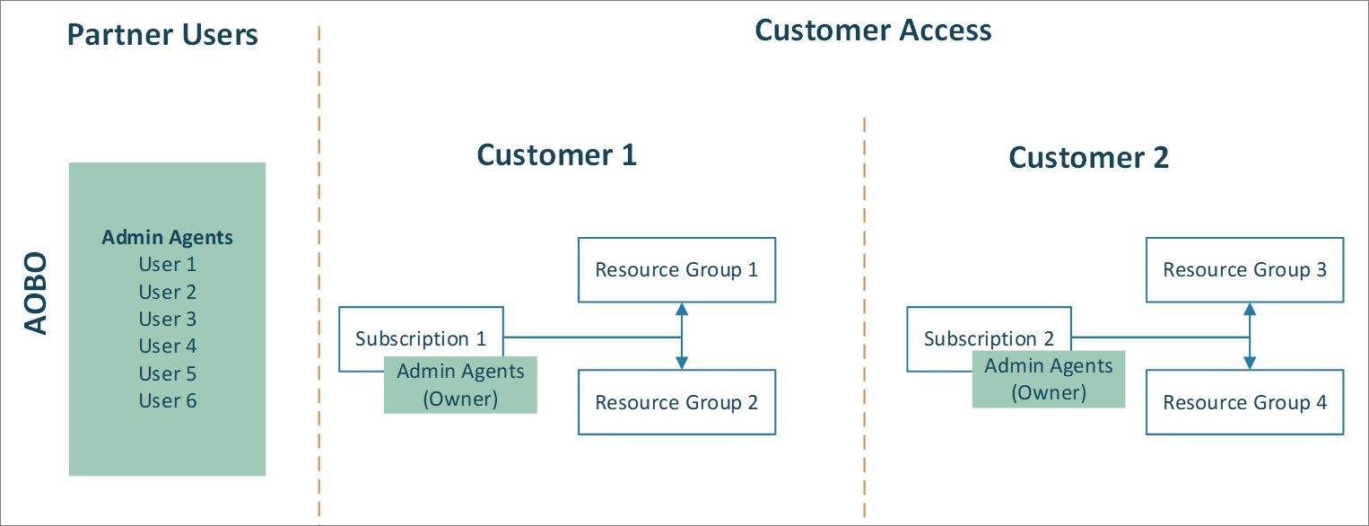
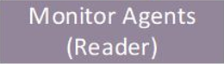
Azure Lighthouse Permissions

Slide 6

Azure Lighthouse: Purpose-built for service providers
Deliver managed-services with greater automation, security, governance & management at-scale
Automate and scale cloud management
Enable greater visibility, security and governance
Build trust with just-enough and just-in-time access
Notes:
Launched last year’s Inspire, Azure Lighthouse is a solution on Azure that is purpose-built for MSPs and management at scale.
It is the language of MSPs on Azure – helping service providers structure well-architected offerings with Azure native security and management tooling:
With more automation – helping to scale managed services delivery
With greater security, governance and visibility – helping to deliver important value propositions to acquire new customers and grow existing customers’ business
All with a unified and comprehensive management portal and toolset for MSPs – driving efficiencies and cost-reduction for the MSP with an at-scale , centralized management experience for MSPs from a unified control plane
Our flagship solution for MSPs, Azure Lighthouse is built to empower all MSPs to profitably and efficiently deliver well-architected managed services for all their customers at-scale.
<CLICK>

Slide 7


Azure Lighthouse: Purpose-built for service providers
Deliver managed-services with greater automation, security, governance & management at-scale
Automatable CI/CD managed services
Achieve cross-tenant, multi-workspace management with Azure Sentinel
Enable greater visibility, security and governance
Build trust with just-enough and just-in-time access
Manage, govern and secure Servers and Kubernetes anywhere with Azure Arc

Slide 8

Azure Lighthouse: Purpose-built for service providers
Deliver managed-services with greater automation, security, governance & management at-scale
Automatable CI/CD managed services
Customer maintains full transparency and control
Achieve cross-tenant, multi-workspace management with Azure Sentinel
Native, unified management solution
Build trust with just-enough and just-in-time access
Manage, govern and secure Servers and Kubernetes anywhere with Azure Arc
Consistent across all licensing models – CSP, EA

Slide 9

Azure Lighthouse: Purpose-built for service providers
Deliver managed-services with greater automation, security, governance & management at-scale
Automatable CI/CD managed services
Customer maintains full transparency and control
Flexible, granular, secure, and precise access
Achieve cross-tenant, multi-workspace management with Azure Sentinel
Native, unified management solution
Azure MFA and Azure AD PIM for just-in-time access
Manage, govern and secure Servers and Kubernetes anywhere with Azure Arc
Consistent across all licensing models – CSP, EA
Single auth token across all customers

Slide 10

Azure Lighthouse + Azure Arc: Bring Azure services and management to any infrastructure
Azure Arc extends Azure management & enables Azure services to run across on-premises, multi-cloud, & edge
Grow revenue by expanding Servers & Kubernetes management in hybrid environments
Extend Azure management across environments
Consolidate tool sets and governance for complex environments
Adopt cloud practices on-premises
Extend Azure Lighthouse security and visibility to hybrid and multi-cloud
Run Azure data services anywhere

Slide 11
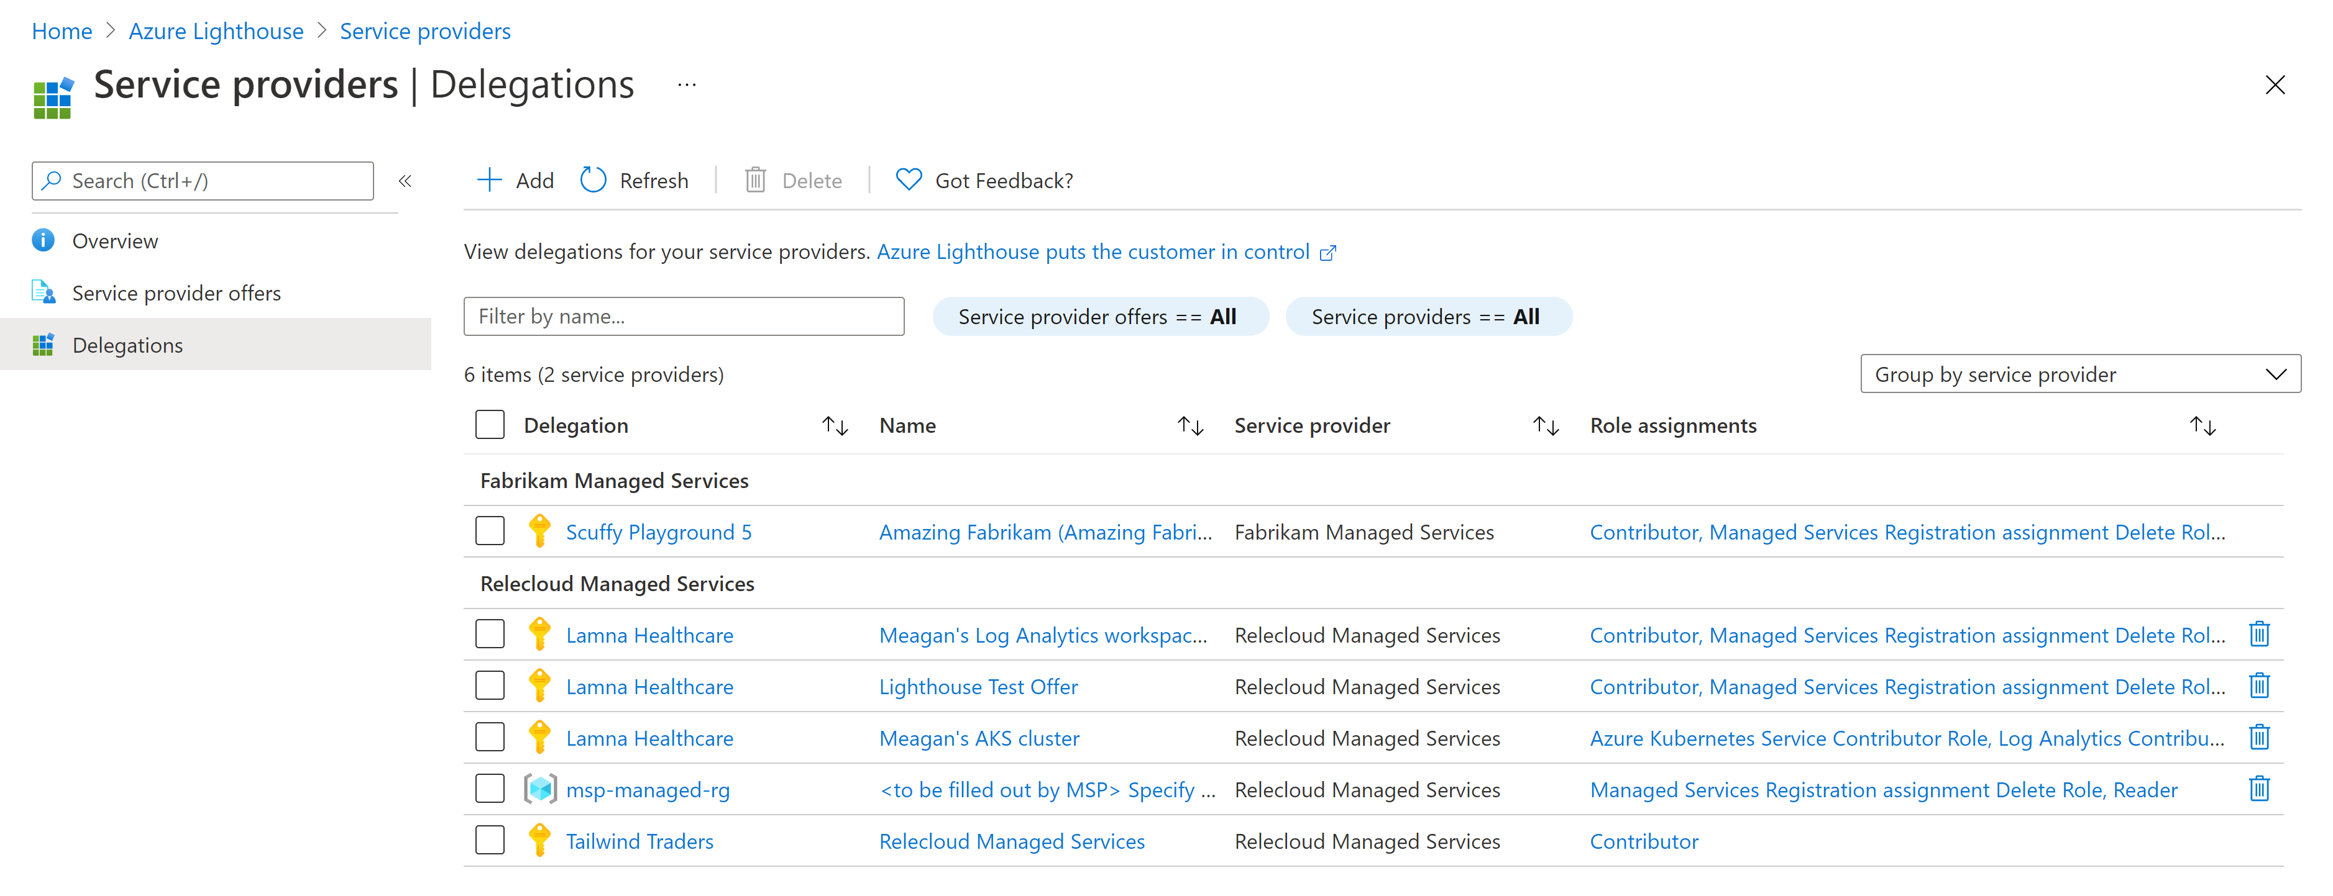
Customer view

Slide 12
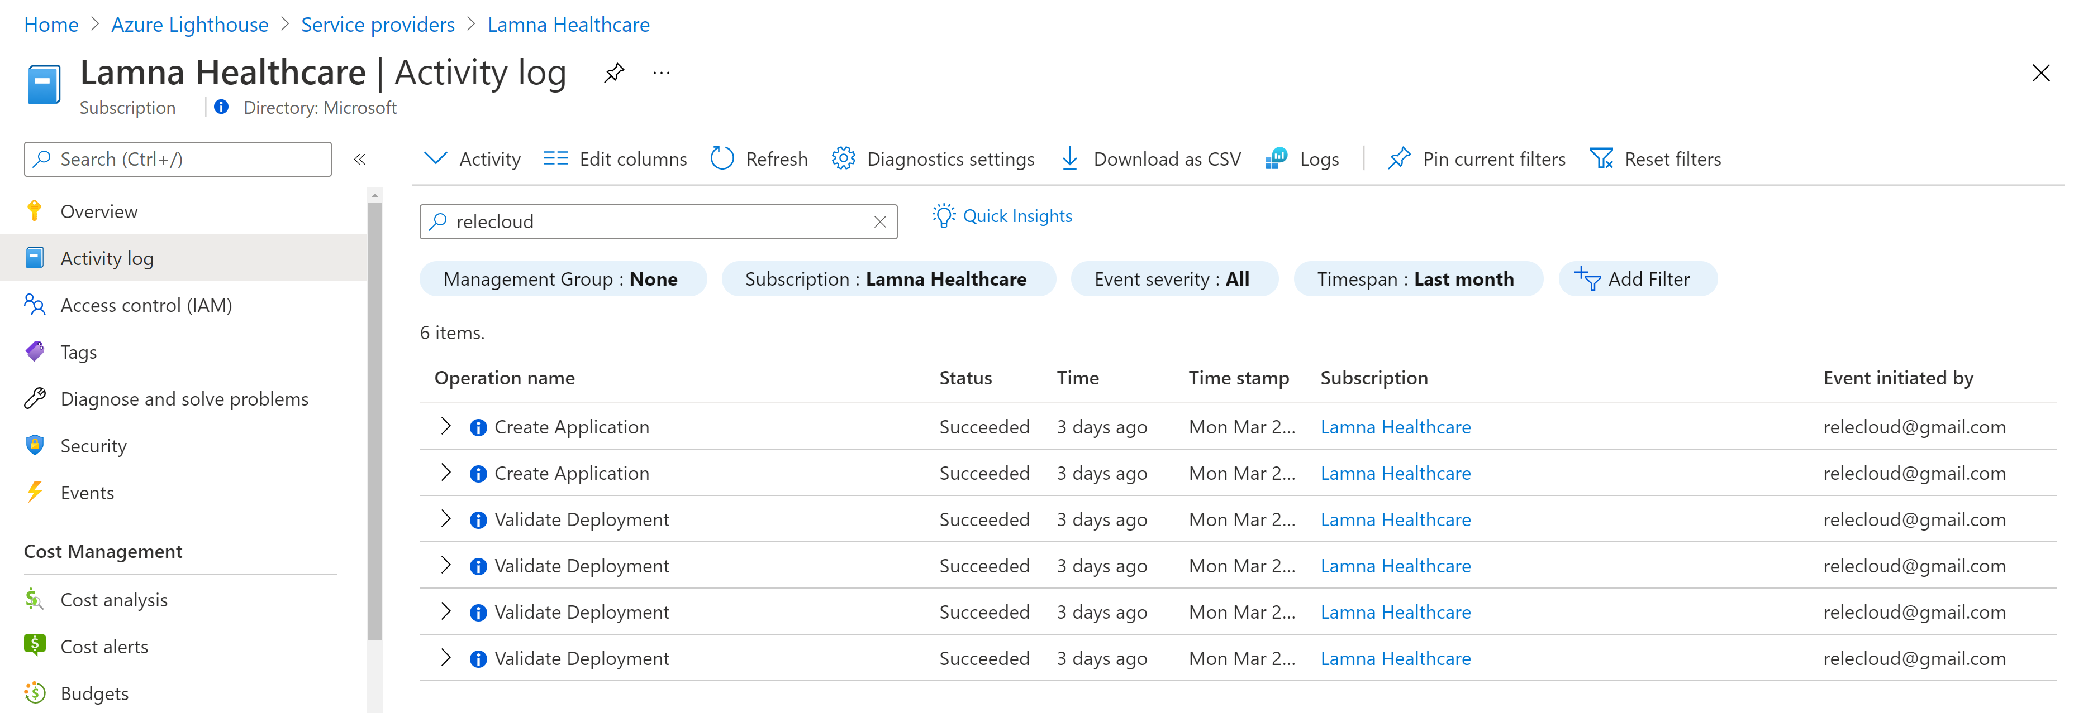
Customer view

Slide 13
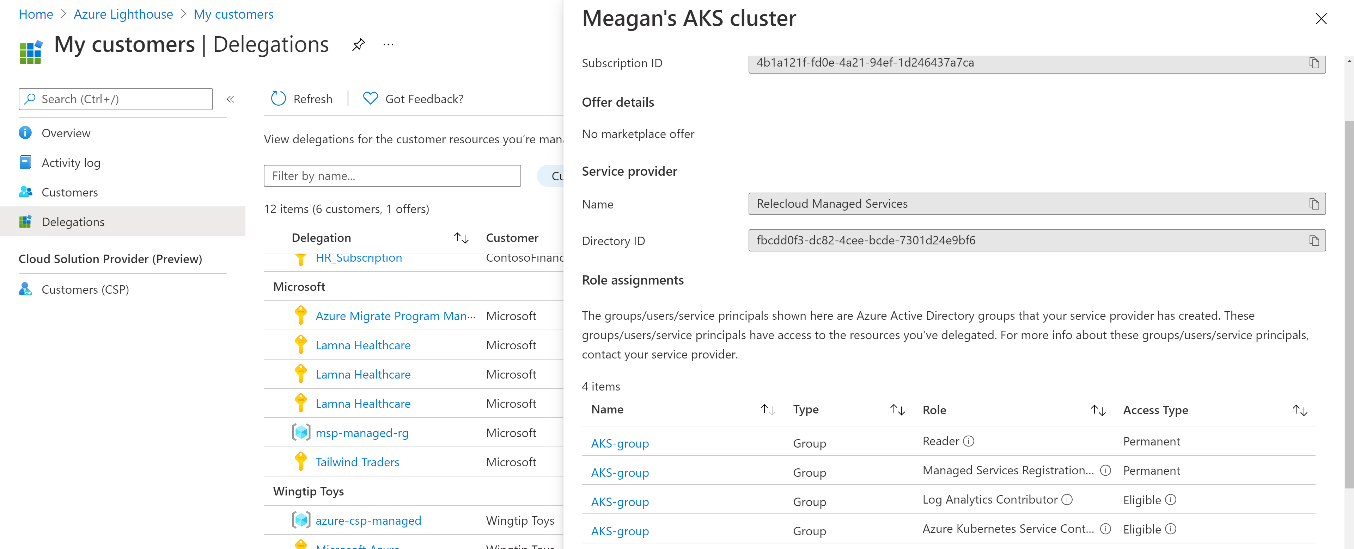
Partner view

Slide 14
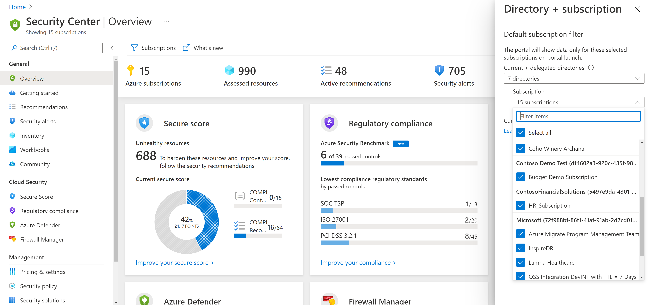
Partner view

Slide 15

Azure Lighthouse: Deployment Options
Deliver managed-services with greater automation, security, governance & management at-scale
via Code (ARM templates, PowerShell, Terraform, etc.)
Microsoft Commercial Marketplace
ARM templates via Azure Portal
Notes:
Launched last year’s Inspire, Azure Lighthouse is a solution on Azure that is purpose-built for MSPs and management at scale.
It is the language of MSPs on Azure – helping service providers structure well-architected offerings with Azure native security and management tooling:
With more automation – helping to scale managed services delivery
With greater security, governance and visibility – helping to deliver important value propositions to acquire new customers and grow existing customers’ business
All with a unified and comprehensive management portal and toolset for MSPs – driving efficiencies and cost-reduction for the MSP with an at-scale , centralized management experience for MSPs from a unified control plane
Our flagship solution for MSPs, Azure Lighthouse is built to empower all MSPs to profitably and efficiently deliver well-architected managed services for all their customers at-scale.
<CLICK>

Slide 16
Option 1: Code | ARM templates, PowerShell, Terraform, etc.
A user with Owner role for the subscription being onboarded (or which contains the resource groups being onboarded) must deploy resources
With CSP subscriptions, any user with Admin Agent role can perform the deployment
How to: Onboard a customer to Azure Lighthouse
Available SDKs:
Azure PowerShell
Azure CLI
REST
.NET
Python
Terraform
Ansible

Slide 17
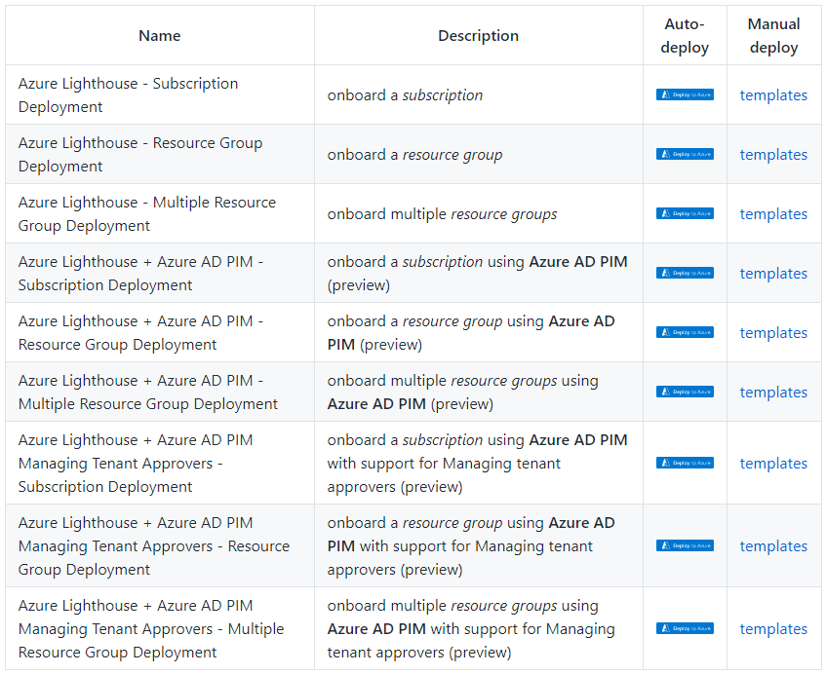
Option 1: Code | ARM templates (autodeploy)
Easy-to-use deploy-to-Azure buttons are available for non-technical customers via the Azure Lighthouse samples on GitHub

Slide 18
Option 1: Code | ARM templates (manual deploy)
Easy-to-use deploy-to-Azure buttons are available for non-technical customers via the Azure Lighthouse samples on GitHub

Slide 19
Azure Lighthouse templates & parameters for offering Managed Services.
Field: | Definition:
mspOfferName | A name describing this definition. This value is displayed to the customer as the title of the offer.
mspOfferDescription | A brief description of your offer (for example, "Contoso VM management offer").
managedByTenantId | Your tenant ID.
authorizations | The principalId values for the users/groups/SPNs from your tenant, each with a principalIdDisplayName to help your customer understand the purpose of the authorization, and mapped to a built-in roleDefinitionId value to specify the level of access (RBAC role)
To onboard this: | Use this Azure Resource Manager template: | And modify this parameter file:
Subscription | delegatedResourceManagement.json | delegatedResourceManagement.parameters.json
Resource group | rgDelegatedResourceManagement.json | rgDelegatedResourceManagement.parameters.json
Multiple resource groups within a subscription | multipleRgDelegatedResourceManagement.json | multipleRgDelegatedResourceManagement.parameters.json
Subscription (when using an offer published to Azure Marketplace) | marketplaceDelegatedResourceManagement.json | marketplaceDelegatedResourceManagement.parameters.jso
https://docs.microsoft.com/en-us/azure/lighthouse/overview
https://docs.microsoft.com/en-us/azure/role-based-access-control/built-in-roles
https://docs.microsoft.com/en-us/azure/lighthouse/samples/
https://github.com/Azure/Azure-Lighthouse-samples

Slide 20
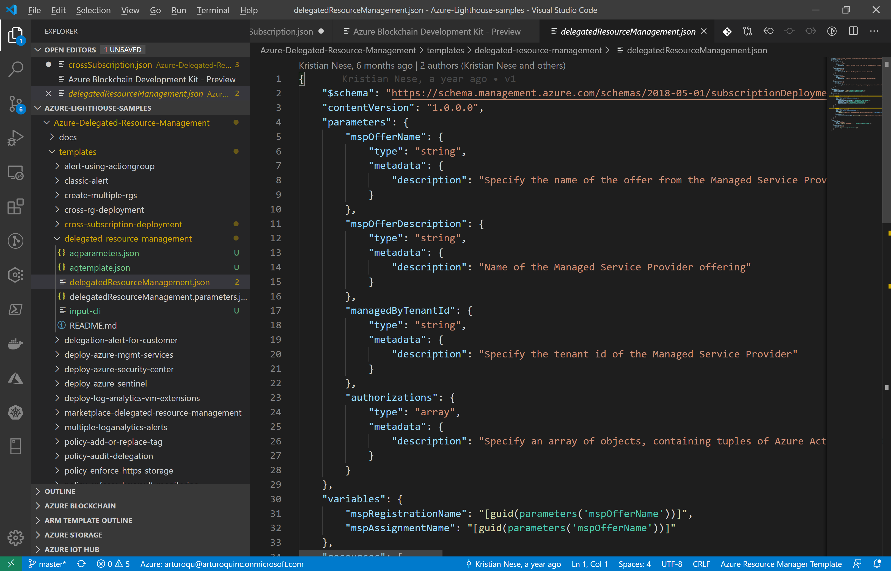
Azure Lighthouse templates in Visual Studio Code

Slide 21
Lighthouse MSP Offer - Template file (JSON) for MSP’s offer to customer.
{
"$schema": "https://schema.management.azure.com/schemas/2018-05-01/subscriptionDeploymentTemplate.json#",
"contentVersion": "1.0.0.0",
"parameters": {
"mspOfferName": {
"type": "string",
"metadata": {
"description": "Specify the name of the offer from the Managed Service Provider"
}
},
"mspOfferDescription": {
"type": "string",
"metadata": {
"description": "Name of the Managed Service Provider offering"
}
},
"managedByTenantId": {
"type": "string",
"metadata": {
"description": "Specify the tenant id of the Managed Service Provider"
}
},
"authorizations": {
"type": "array",
"metadata": {
"description": "Specify an array of objects, containing tuples of Azure Active Directory principalId, a Azure roleDefinitionId, and an optional principalIdDisplayName. The roleDefinition specified is granted to the principalId in the provider's Active Directory and the principalIdDisplayName is visible to customers."
}
}
},
"variables": {
"mspRegistrationName": "[guid(parameters('mspOfferName'))]",
"mspAssignmentName": "[guid(parameters('mspOfferName'))]"
},

Slide 22
Lighthouse MSP Offer - Parameter file (JSON) for MSP’s offer to customer.
{
"$schema": "https://schema.management.azure.com/schemas/2015-01-01/deploymentParameters.json#",
"contentVersion": "1.0.0.0",
"parameters": {
"mspOfferName": {
"value": ”Managed Services Offering from XXXX” # Make this Name something compelling and enticing to the customer
},
"mspOfferDescription": {
"value": ”Service to manage XXXX, with permissions XXXX” # Make this a good description of your offer.
},
"managedByTenantId": {
"value": "5a3326ad-f43f-480d-85b2-26b386f0ae20” # This is the GUID of the AAD Tenant of the provider
},
"authorizations": {
"value": [
{
"principalId": "68e05db2-275a-4b82-9a03-c2b1a7249775", # In this case we have defined one principal IDs from # the provider AAD tenant, either for a user or group, # in GUID format.
"roleDefinitionId": "b24988ac-6180-42a0-ab88-20f7382dd24c", # This is the requested delegated role, also in # GUID format, in this case “contributor” role.
"principalIdDisplayName": "Tier 1 Support”
},
]
}

Slide 23
How to onboard a customer using Azure POWERSHELL Deploy the Lighthouse Azure Resource Manager templates/parameters
# Log in first with Connect-AzAccount if you're not using Cloud Shell ……(really?...use Cloud Shell)
# Deploy Azure Resource Manager template using template and parameter file locally
New-AzDeployment -Name <deploymentName> ` # If you get an error, remove -name
-Location <AzureRegion> `
-TemplateFile <pathToTemplateFile> `
-TemplateParameterFile <pathToParameterFile> `
-Verbose
# Or
# Deploy Azure Resource Manager template that is located externally
New-AzDeployment -Name <deploymentName> ` # If you get an error, remove -name
-Location <AzureRegion> `
-TemplateUri <templateUri> `
-TemplateParameterUri <parameterUri> `
-Verbose
Get-AzContext
Get-AzManagedServicesAssignment -Scope "/subscriptions/{delegatedSubscriptionId}"

Slide 24
How to onboard a customer using Azure CLI Deploy the Lighthouse Azure Resource Manager templates/parameters
# Log in first with az login if you're not using Cloud Shell (preferred way is to use Azure Cloud Shell)
# Deploy Azure Resource Manager template using template and parameter file locally
az deployment create –name <deploymentName> \ # If you get an error, remove --name
--location <AzureRegion> \
--template-file <pathToTemplateFile> \
--parameters <parameters/parameterFile> \
--verbose
# Or
# Deploy external Azure Resource Manager template, with local parameter file
az deployment create –name <deploymentName \ # If you get an error, remove --name
--location <AzureRegion> \
--template-uri <templateUri> \
--parameters <parameterFile> \
--verbose
az account list
az managedservices assignment list

Slide 25
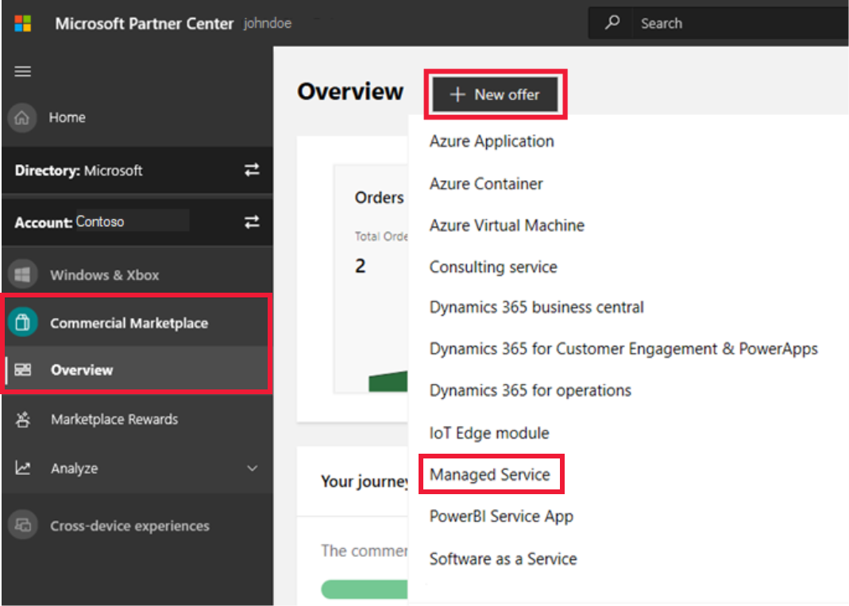
Option 2: Microsoft Commercial Marketplace
Partner requirements:
Account in Partner Center
Silver or Gold Cloud Platform competency level or Azure Expert MSP status
How to: Create a Managed Service offer in Microsoft Commercial Marketplace

Slide 26
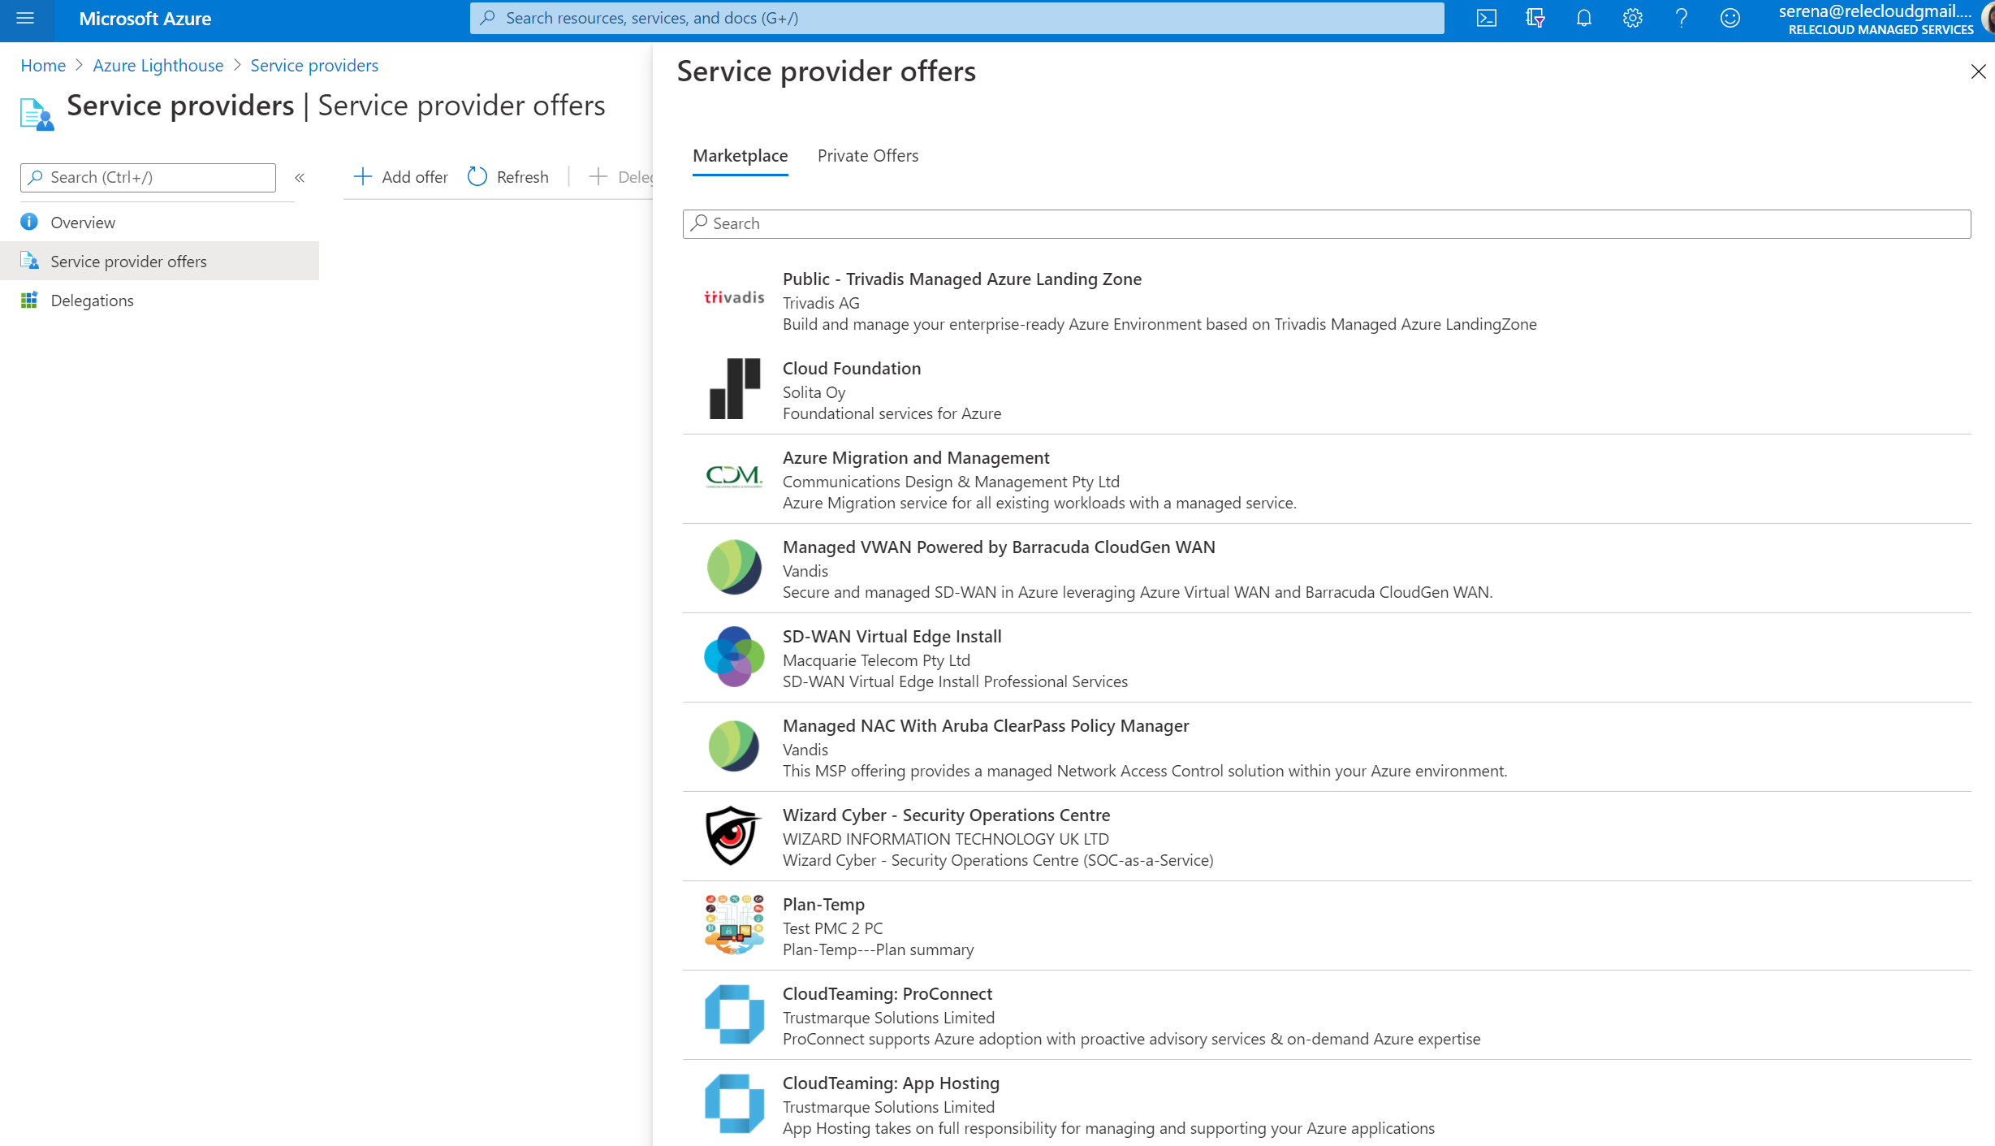
Option 2: Microsoft Commercial Marketplace
Customers select offers in Azure Portal Service offer blade
How to: Create a Managed Service offer in Microsoft Commercial Marketplace

Slide 27
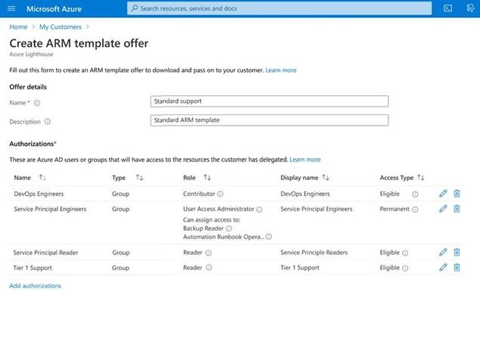
Option 3: ARM templates via Azure Portal
Quickly and easily author ARM template offers in the Azure Portal

Slide 28
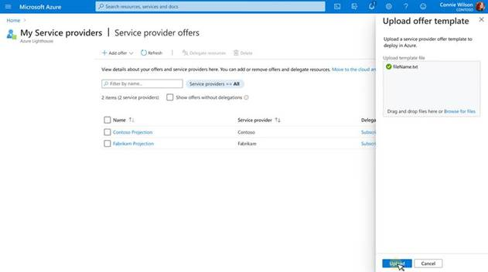
Option 3: ARM templates via Azure Portal
Quickly and easily deploy ARM templates via the My Service providers blade in the Azure Portal

Slide 29
Unique Selling Proposition (USP)
Single pane of glass to view and manage all customers
Automate & scale: management & governance
Comprehensive management toolkit for cloud & hybrid

Slide 30
Lighthouse Pricing
Azure Lighthouse is free to use for customers and partners.
Azure Lighthouse, powered by the Azure delegated resource management technology, is available at no additional charge.
Partners who use these capabilities on Azure services such as Log Analytics, Security Center, etc. will continue to pay for the underlying services.
If an underlying service is free (Azure Policy, Azure Resource Health and others), then there are no changes, and these services will continue to be free of charge.
Alle Preise unverbindliche Richtpreise basierend auf Licensewise
Irrtümer und Tippfehler vorbehalten

Slide 31
Links
Azure Lighthouse | Microsoft Azure
Azure Lighthouse samples and templates | Microsoft Docs
Link your partner ID to track your impact on delegated resources | Microsoft Docs
Azure Lighthouse - Learn | Microsoft Docs ~4h

